Slide 1


Colorectal cancer susceptibility genes: findings from whole genome, exome and targeted sequencing of early onset and multiple-case families
Bernard Pope, Khalid Mahmood, Mark Clendenning, Christophe Rosty, Marie Lorans, Harindra Jayasekara, Neil O’Callaghan, Susan Preston, Daniel J. Park, Fleur Hammet, Tu Nguyen-Dumont, Ashton Connor, Steven Gallinger, David Duggan, Graham Casey, Stephen N. Thibodeau, John L. Hopper, Melissa C. Southey, Aung K. Win, Finlay A. Macrae, Ingrid M. Winship, Mark A. Jenkins, Daniel D. Buchanan for the Australasian Colorectal Cancer Family Registry.
www.pedigree.org.au

Slide 2
Missing Heritability for Colorectal Cancer
Colorectal cancer (CRC) has a strong familial component.
However, only 2-5% of CRC overall risk can be explained by mutations in known genes
MMR genes, APC, MUTYH, STK11, BMPR1A, SMAD4 , PTEN, POLE and POLD1.
In this study we consider individuals who are highly suspected to carry previously unidentified, moderate to high risk germline DNA variants:
Have a strong family history of CRC and other cancers OR have developed CRC at an early age.
Are not diagnosed with known inherited syndromes (e.g. Lynch syndrome, Familial adenomatous polyposis, etc).

Slide 3
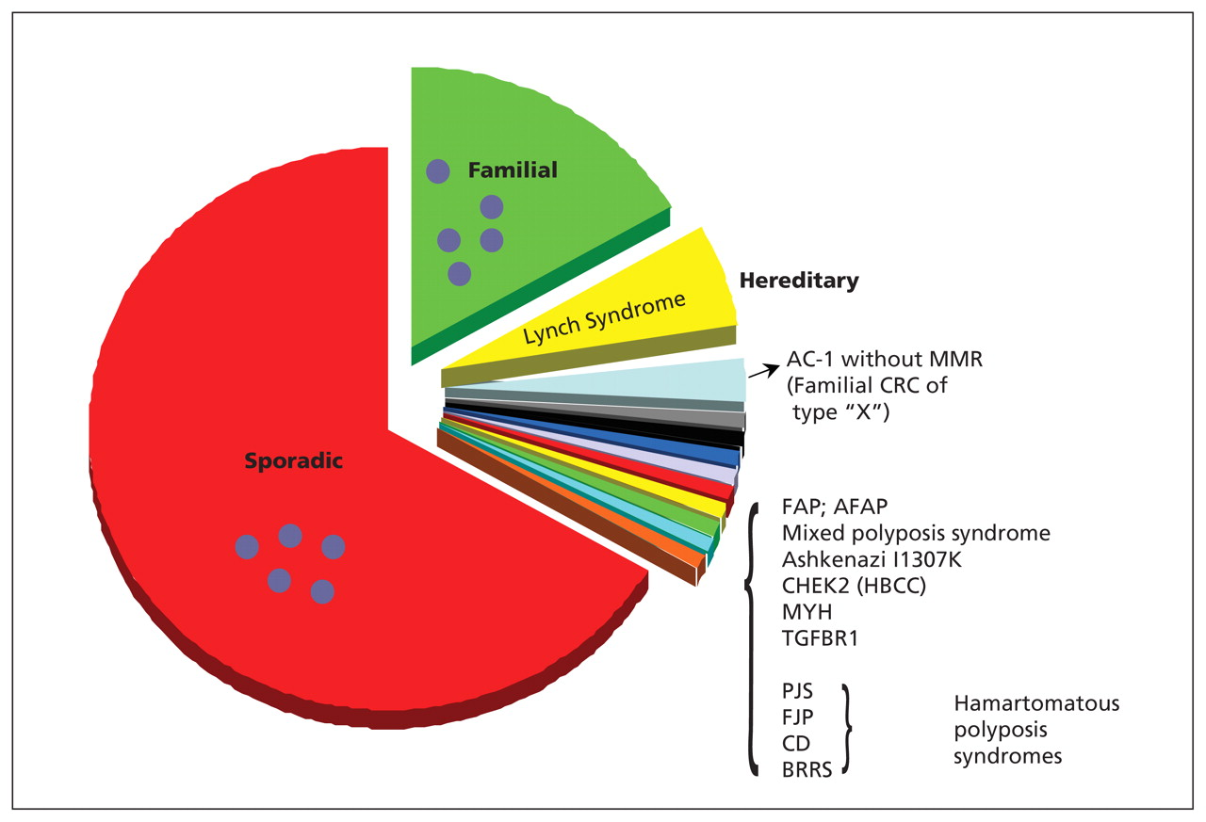
Breakdown of CRC causes
FCCTX families fulfill the Amsterdam 1 criteria for Lynch Syndrome, but do not have hereditary DNA MMR deficiency.
Early-onset and Familial CRC cases – “missing heritability”

Slide 4
Aims
Identify, using WGS and WES, carriers of mutations in known CRC/polyposis susceptibility genes in multiple case families, including FCCTX.
Determine the prevalence of and phenotypes associated with carriers of likely pathogenic variants in recently identified CRC risk genes POLE, POLD1, NTHL1 and FAN1 in multiple case families or early onset CRC cases, using a combination of WGS/WES and targeted gene sequencing.

Slide 5
WGS/WES sample selection
Whole genome (WGS) and exome sequencing (WES)
Blood-derived DNA from 100 CRC-affected families
57 = FCCTX
14 = modified FCCTX
19 = multiple-case families (no criteria met)
10 = early-onset CRC singletons
Whole genome sequencing
36 individuals from 19 families
Illumina TruSeq 150bp PE sequencing on Hi-Seq XTen to 30x mean depth
100bp PE sequencing HiSeq2500 to 100x mean depth
Whole exome sequencing
164 individuals from 81 families
Agilent SureSelect All Exon V4 (51Mb) capture
Range 1-4 CRC-affected individuals sequenced per family
Range 0-7 early-onset polyp-affected (polyp-subtyped) sequenced per family
Notable family – 21 individuals sequenced (3 x CRC, 7 x early onset polyps, 1 x cervix, 10 x unaffected)
Families | 100
Individuals | 200
CRC-affected | 170
Notes:
Modified type x: one person under 55 instead of 50.

Slide 6
Targeted sequencing sample selection
Targeted Sequencing of 4 CRC genes in early onset CRC population samples
Blood-derived DNA from 830 population based probands from the Australasian Colorectal Cancer Family Registry (Colon-CFR)
Individuals selected with CRC onset < 60 years of age
Hi-Plex protocol (www.hiplex.org)
Highly multiplexed PCR-based targeted sequencing
Notes:
XXX WES + WGS number of individuals (36 + 196) does not add up to stated individuals = 216.

Slide 7
Aim 2 gene selection
The following 4 genes were selected based on recent literature linking germline mutations to CRC, adenomas and polyposis:
POLE and POLD1
Palles et al, Nature Genetics, 2013
Focus has been on exonuclease domain mutations
Predicted to impair correction of mispaired bases inserted during DNA replication
Implicated in other cancers, such as endometrial
Hypermutator phenotype associated with somatic mutations in tumours
NTHL1
Weren et al, Nature Genetics, 2015
Part of the base excision repair pathway.
Individuals with homozygous germline variant at increased risk of adenomatous polyposis and CRC.
FAN1
Segui, Mina et al 2015 Gastroenterology - ~3% of FCCTX families
However: review by Broderick et al 2016 Gastroenterology, concluded that there was insufficient data to decide if FAN1 (amongst others) was related to familial CRC
involved in interstrand cross-link repair (Fanconi anemia)
interacts with MMR components, such as MLH1, PMS2 and PMS1, plays a role in maintaining genome integrity
Notes:
Improved res.

Slide 8
Bioinformatics analysis workflows
Notes:
Next slide should be known pathogenic variants table from CRC genes
KM – amended some text

Slide 9
Variant filtering strategy
Variant filters
Quality
Depth > 10 (WGS/WES)
Depth > 30 (Hi-Plex)
Variant read frequency > 20% (HiPlex)
Population frequency
Ultra Rare variants (ExAC AF* < 0.0005)
Functional prediction
CADD > 20
REVEL > 0.5
*ExAC total populations
Notes:
Filtering for NTHL1 was more lenient to allow us to keep recessive (biallelic variants) – though we did not find any anyway.

Slide 10
Aim 1 results – known CRC genes
No. | CRC genes | Loss of Function (unique variants) |  | Likely pathogenic missense
1 | APC | 1 | c.2097G>A | 3 | p.Thr1160Lys, p.Ala1670Val, p.Pro1934Leu
2 | AXIN2 | 1 | c.1049delC | 0
3 | BMPR1A | 0 |  | 2 | p.Trp253Cys, p.Arg478His
4 | EPCAM | 0 |  | 0
5 | SCG5/GREM1 | 0 |  | 1 | p.Thr26Asn
6 | MLH1 | 0 |  | 2 | p.His308Asn, Lys751Arg(2)
7 | MSH2 | 0 |  | 3 | p.Gly322Val(1), p.Asn596Ser(3), p.Gln681Glu
8 | MSH6 | 0 |  | 3 | p.Thr605Ala, p.Met703Val, p.Pro1087His
9 | PMS2 | 0 |  | 2 | p.Arg211Gln, p.Phe163Leu
10 | MUTYH | 0 |  | 1 | p.Asp147His
11 | PTEN | 0 |  | 0
12 | SMAD4 | 1 | c.126_129delTTTG | 0
13 | STK11 | 1 | c.1791delT | 1 | p.Arg106Trp
14 | TP53 | 0 |  | 2 | p.Val272Met, p.Pro152Leu
LOF mutations can help us remove families from burden test in new CRC risk gene discovery.
Notes:
Known CRC genes. Most commonly appear on gene panels for CRC and polyposis testing.
Variants with (N) next to them are classified benign in InSIGHT.

Slide 11
Aim 1 results – other cancer genes
No. | Add. CRC genes | Loss of Function (unique variants) |  | Likely pathogenic missense (unique variants)
1 | RPS20 | 0 |  | 0
2 | CDH1 | 0 |  | 1 | p.Glu445Ala
3 | MLH3 | 1 | c.2395G>T | 0
4 | MSH3 | 0 |  | 0
5 | RNF43 | 1* | c.988C>T | 0
6 | BRCA1 | 1* | c.2681_2682delAA | 4 | p.Glu1017Lys, p.Val772Ala, p.Arg496His, p.Thr231Met
7 | BRCA2 | 2 | c.3181A>T, c.7495C>T | 2 | p.Val2759Leu
8 | ATM | 1 | c.7629+2T>C | 8 | p.Ile323Val, p.His448Tyr, p.Thr656Ile, p.His943Leu, p.Gly1459Arg, p.Ala1954Gly, p.Arg2263Lys, p.Arg2832His
* FCCTX family carried both BRCA1 and RNF43 truncating variants
Notes:
RPS20 suggested by Broderick et al as new susceptibility gene, but not found in our study.
Other cancer related genes that showed likely pathogenic variants in our cohort.

Slide 12
FAN1 variants in FCCTX and EOCRC
Fam/ID | Sex | Age CRC Dx |  | FAN1 Variant | ExAC_All | ExAC_NFE | CADD | REVEL | Polyphen2 | SIFT
A.1 | M | 47 | FCCTX | c.2854C>T, p.Arg952* | 5.8E-05 | 9.0E-05 | 20.3 | -- | -- | --
A.2 | M | 69 | FCCTX | c.2854C>T, p.Arg952* | 5.8E-05 | 9.0E-05 | 20.3 | -- | -- | --
B.1 | M | 43 | EOCRC | c.2245C>T, p.Arg749* | 1.6E-05 | 1.5E-05 | 37 | -- | -- | --
C.1 | F | 47 | EOCRC | c.1961C>T, p.Pro654Leu | 2.1E-04 | 3.6E-04 | 26.9 | 0.75 | PD(0.992) | D(0)
D.1 | M | 47 | EOCRC | c.1772G>A, p.Arg591Gln | 1.6E-05 | 1.5E-05 | 33 | 0.34 | PD(0.999) | D(0)
E.1 | M | 32 | EOCRC | c. 1006delAinsGGAT, p.Ile336delinsGlyPhe | -- | -- | -- | -- | -- | --
FCCTX
EOCRC
(pathogenic)
Notes:
This is results for Aim 2.

Slide 13
Results: FAN1
FAN1 | No. | Missense | Truncating | Combined | OR [95%CI] | p value*
FCCTX | 100 | 0 | 1 (1.0%) | 1 (1.0%) | 3.14 [0.44-22.7] | 0.5
EOCRC | 830 | 3 (0.4%) | 1 (0.1%) | 4 (0.5%) | 1.5 [0.6-4.1] | 0.35
ExAC | 53105 | 122 (0.2%) | 48 (0.1%) | 170 (0.3%) | ref
FCCTX
EOCRC
(pathogenic)
*Binomial exact test to compare frequency between the FCCTX or EOCRC groups and ExAC
Notes:
Didn’t see a significant enrichment of FAN1 variants compared to ExAC.

Slide 14
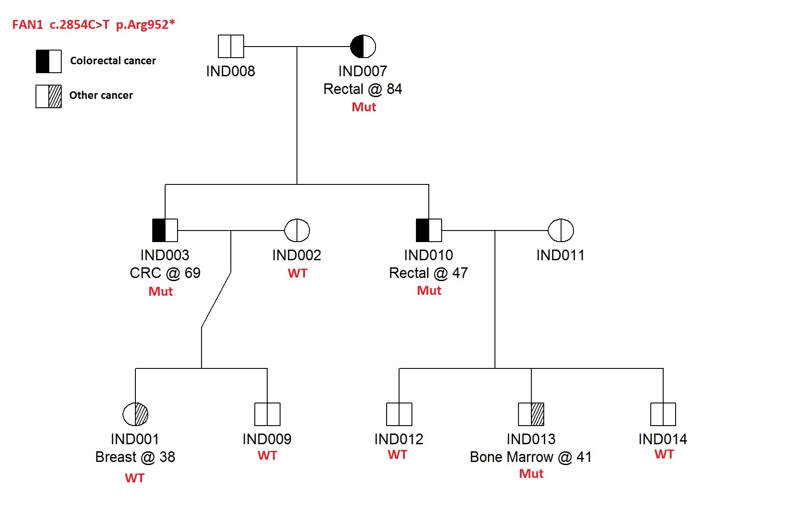
Highlighted FAN1 family
Haplotype analysis revealed this family not related to the Spanish family (Segui et al 2015)
Notes:
In 3 CRC individuals in Amsterdam 1 triad, they were all carriers. Found an additional carrier with Bone Marrow cancer.

Slide 15
Results: NTHL1
NTHL1 | No. | Missense | Truncating | Combined | OR [95%CI] | p value*
FCCTX | 100 | 0 | 2 | 2 (2.0%) | 16.9 [4.1-70.6] | 0.007
EOCRC | 830 | 3 | 1 | 4 (0.5%) | 4.0 [1.5-11.1] | 0.02
ExAC | 53105 | 50 | 14 | 64 (0.1%) | ref
FCCTX
EOCRC
(pathogenic)
*Binomial exact test to compare frequency between the FCCTX or EOCRC groups and ExAC
Notes:
These are heterozygous variants, risk likely to be moderate compared to homozygous carriers.
Did not see any of the most commonly reported Q90* in biallelics.

Slide 16
Results: POLE
POLE | No. | Missense | Truncating | Combined | OR [95%CI] | p value*
FCCTX | 100 | 6 | 0 | 6 (6.0%) | 11.2 [4.9-25.8] | 3.5e-5
EOCRC | 830 | 13 | 0 | 13 (1.6%) | 2.8 [1.6-4.9] | 0.001
ExAC | 53105 | 279 | 22 | 301 (0.6%) | ref
FCCTX
EOCRC
(pathogenic)
*Binomial exact test to compare frequency between the FCCTX or EOCRC groups and ExAC
Notes:
Mention that current focus in on the Exonuclease domain (indicated in green). We found only one variant in this domain.
Did see significant enrichment of likely pathogenic missense variants in FCCTX compared to ExAC.

Slide 17
Results: POLD1
POLD1 | No. | Missense | Truncating | Combined | OR [95%CI] | p value*
FCCTX | 100 | 1 | 1 | 2 (2.0%) | 11.0 [2.7-45.4] | 0.016
EOCRC | 830 | 17 | 0 | 17 (2.0%) | 11.3 [6.7-19.0] | <0.0001
ExAC | 53105 | 79 | 19 | 98 (0.2%) | ref
FCCTX
EOCRC
(pathogenic)
*Binomial exact test to compare frequency between the FCCTX or EOCRC groups and ExAC
Notes:
Here we see more variants in the exonuclease domain of POLD1 (compared to what we saw for POLE) in our cohort.
We appear to have significant enrichment in the early onset CRC group.

Slide 18
Summary and Future Directions
Summary
Established CRC susceptibility genes account for a small proportion of families meeting FCCTX, including in genes associated with rare polyposis syndromes
Identified additional CRC-affected families with FAN1 likely pathogenic variants
No significant enrichment of likely pathogenic variants in FAN1
Enrichment of POLE and POLD1 likely pathogenic variants in both familial and early onset CRC – including variants outside the exonuclease domains
Enrichment of monoallelic NTHL1 variants in both familial and early onset CRC
Ongoing work
Additional 3,000 CRC-affected probands and controls from Colon-CFR
Improve variant classification in POLE, POLD1 and NTHL1 genes
Risks of CRC associated with monoallelic NTHL1 carriers
Candidate genes from WGS/WES in FCCTX – including structural variant analysis
Notes:
The ongoing 3000 CRCs will be sequenced with the same Hi-Plex panel.

Slide 19

Acknowledgments Funding - NCI/NIH and NHMRC of Australia
Colorectal Oncogenomics Group, UoM
Dr Daniel Buchanan
Dr Mark Clendenning
Assoc. Prof. Christophe Rosty
Dr Harindra Jayasekara
Mr Neil O’Callaghan
Ms Susan Preston
Ms Marie Lorans
Ms Sharelle Joseland
Melbourne Bioinformatics, UoM
Dr Khalid Mahmood
Assoc. Prof. Danny Park
Genetic Epidemiology Laboratory, UoM
Prof. Melissa Southey
Members GEL
Royal Melbourne Hospital
Prof. Ingrid Winship
Prof. Finlay Macrae
Centre for Epidemiology & Biostatistics, UoM
Prof. Mark Jenkins
Prof. John Hopper
Dr Aung Win
CRC unit of CEB
Colon Cancer Family Registry Collaborators
Ontario Institute of Cancer Research
Prof. Steven Gallinger
Dr Ashton Connor
University of Virginia, School of Medicine
Prof. Graham Casey
Translational Genomics Research Institute (TGEN)
Assoc. Prof. David Duggan
Mayo Clinic
Prof. Stephen Thibodeau
Prof. Laney Lindor
Australasian Colorectal Cancer Family Registry
www.pedigree.org.au

Slide 20


© Copyright The University of Melbourne 2011

Slide 21
CRC and Polyposis susceptibility genes
CRC and polyposis genes
CRC and/or polyposis
Non-polyposis
Polyposis
Phenotype
MMR-deficient
MMR-proficient
Adenomatous
Hamartomatous
Mixed
Serrated
Dominant
Recessive
Core genes of familial CRC/polyposis genetic testing
MSH2, MLH1,MSH6,
PMS2, EPCAM
Lynch syndrome
APC
FAP
MUTYH
MAP
STK11, PTEN,
SMAD4, BMPR1A
PJS, CS, JPS
GREM1
HMPS
No mutation
No mutation
No mutation
No mutation
No mutation
No genetic explanation
Suspected Lynch
Familial Colorectal Cancer Type X
Unexplained polyposis/CRC
Novel genes/
associations
A subset of the unexplained cases are likely attributable to:
POLE
MUTYH
POLE
POLD1
POLE
POLD1
NTHL1
MSH3
WGS/WES
EXO1
FAN1, RPS20, ???
???
RNF43
FAP: Familial Adenomatous Polyposis, MAP: MUTYH-associated-polyposis, PJS: Peutz-Jeghers Syndrome, CS: Cowden Syndrome, JPS: Juvenile Polyposis Syndrome, HMPS: Hereditary Mixed Polyposis syndrome
Notes:
Genes at bottom identified in the last few years.

